Slide 1
Motion Models (cont)

Slide 2
Odometry Model
bar indicates odometer coordinates
Robot moves from to .
Odometry information .

Slide 3
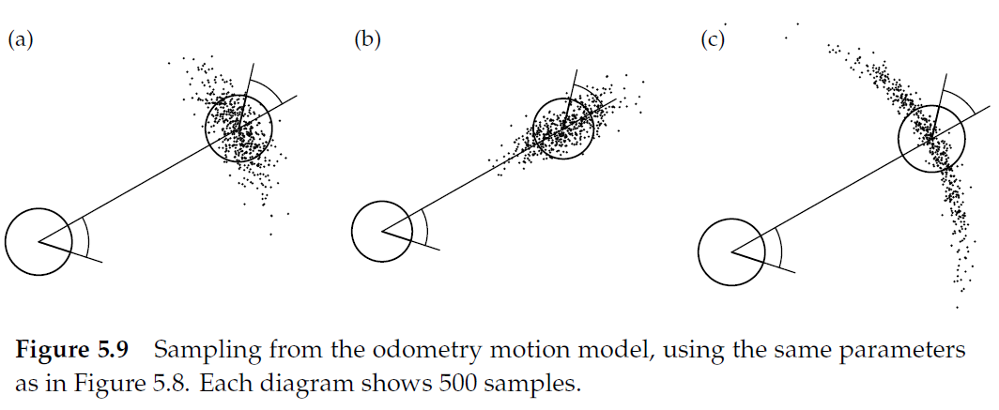

Slide 4
Odometry Motion Model
the key to computing for the odometry motion model is to remember that the robot has an internal estimate of its pose
true poses

Slide 5
Odometry Motion Model
the key to computing for the odometry motion model is to remember that the robot has an internal estimate of its pose
robot’s internal poses

Slide 6
Odometry Motion Model
the control vector is made up of the three motions made by the robot
use the robot’s internal pose estimates to compute the δ

Slide 7
Odometry Motion Model
use the true poses to compute the δ
as with the velocity motion model, we have to solve the inverse kinematics problem here

Slide 8
Odometry Motion Model
recall the noise model
which makes it easy to compute the probabilities of observing the differences in the δ

Slide 9
Calculating the Posterior Given x, x’, and u
Algorithm motion_model_odometry(x,x’,u)
return p₁ · p₂ · p₃
odometry values (u)
values of interest (x,x’)

Slide 10
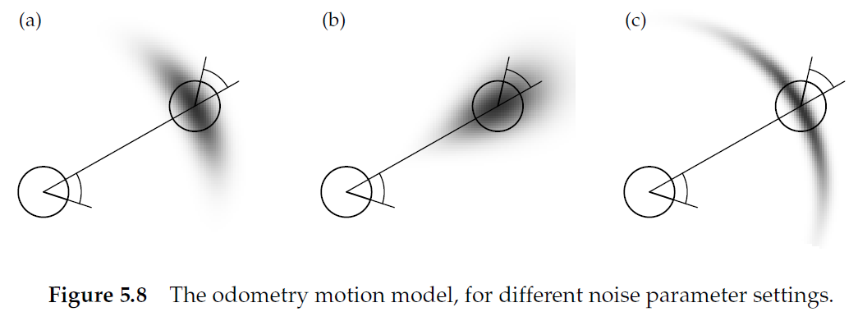

Slide 11
Recap
velocity motion model
control variables were linear velocity, angular velocity about ICC, and final angular velocity about robot center

Slide 12
Recap
odometric motion model
control variables were derived from odometry
initial rotation, translation, final rotation

Slide 13
Recap
for both models we assumed the control inputs u_{t} were noisy
the noise models were assumed to be zero-mean additive with a specified variance
actual velocity
commanded velocity
noise

Slide 14
Recap
for both models we assumed the control inputs u_{t} were noisy
the noise models were assumed to be zero-mean additive with a specified variance
actual motion
commanded motion
noise

Slide 15
Recap
for both models we studied how to derive
given
x_{t-1} current pose
u_{t} control input
x_{t} new pose
find the probability density that the new pose is generated by the current pose and control input
required inverting the motion model to compare the actual with the commanded control parameters

Slide 16
Recap
for both models we studied how to sample from
given
x_{t-1} current pose
u_{t} control input
generate a random new pose x_{t} consistent with the motion model
sampling from is often easier than calculating directly because only the forward kinematics are required

Slide 17
Recap
see section 5.5 of the textbook for an extension of the motion models to include a map of the environment
in particular notice the numerous assumptions and approximations that need to be made to make the computations tractable
also, pay attention to the consequences of making such assumptions and approximations

